Slide 1


Slide 2


Innovation is always risky
Leading organizations reported that over
40% of ideas do not break even
So…how can we take the risk out of innovation?
Experimentation

Slide 3





















Leading companies use experimentation to understand the impact of most business decisions
Travel
Telecom
Consumer
Retail
Dining
1
2
3
4
5
6
Consumer Credit
Marketing
Pricing & Promotions
Labor and Operations
Capital Expenditures
Merchandising

Slide 4
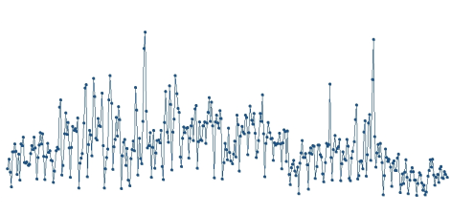


Why is testing challenging?
1
Real world data is extremely noisy
2
Test stores and markets are often different from the rest of the network
CONTROL
TEST
Sales
3
Analysis is slow; business is fast
4
Varying analysis approaches across the organization

Slide 5




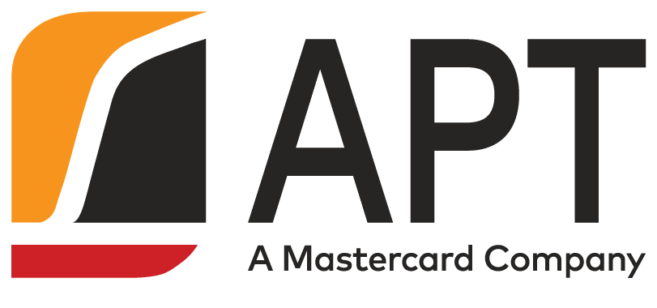




The Test & Learn Approach
Key LearningS from Previous Tests
Roll Out Targeted Program
Generate
Hypotheses
Use a predictive model to optimize rollout to maximize ROI
4
1
Business leaders have ideas for improving the business
3
2
Design and
implement Test
Measure Impact
Answer key questions before program rollout:
Will it work?
How can we improve it?
How should we target it?
Test the idea with a group of customers or markets
Identify naturally occurring events

Slide 6
APT – ABI Relationship Background
APT and ABI InBev have worked together since an initial pilot project in early 2012
Today
Contract Renewal
Internal Expansion
APT 2.0 project kicks-off; relationship expands to include ABI Colombia, Ecuador, and Peru
Internal Expansion
ABI renews APT Test & Learn license for another 3 years across 17+ countries
Initial Rollout
Relationship expands to Mexico, DR, and Southern Cone; coolers analysis aggregated globally
ABI Pilot
APT expands to analyze wide variety of programs, such as coolers installations, in-store marketing, and promotions
ABI licensed the APT software across 8 initial geographies, using the software to drive annual planning
APT and ABI ran a pilot project in the US and Canada
Early 2012
2013
2013+
2014
2015
2017

Slide 7
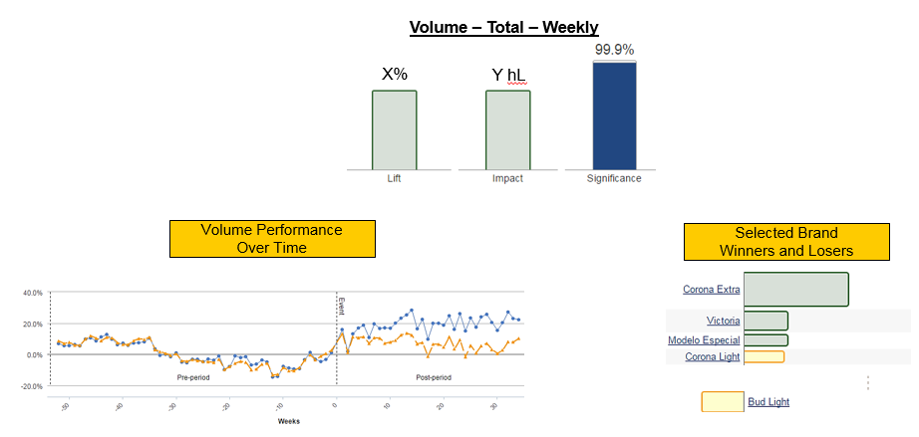
Sample Test & Learn Insights in Trade Marketing
Case Study: Coronizacion
Following store remodel, total volume increased X%, translating to +YYMM incremental liters across all POCs in the program

Slide 8
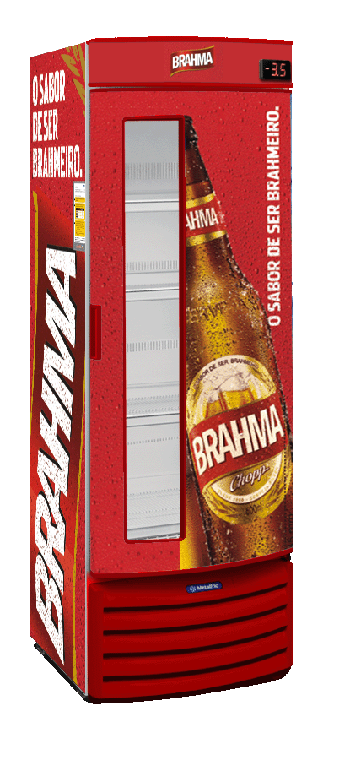
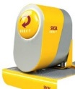


AB Inbev is now extending APT to capture & organize implementation data and drive monthly tracking
Test & Learn
APT 2.0
+8%
+18%
New Process
+33% ??
+7%

Slide 9
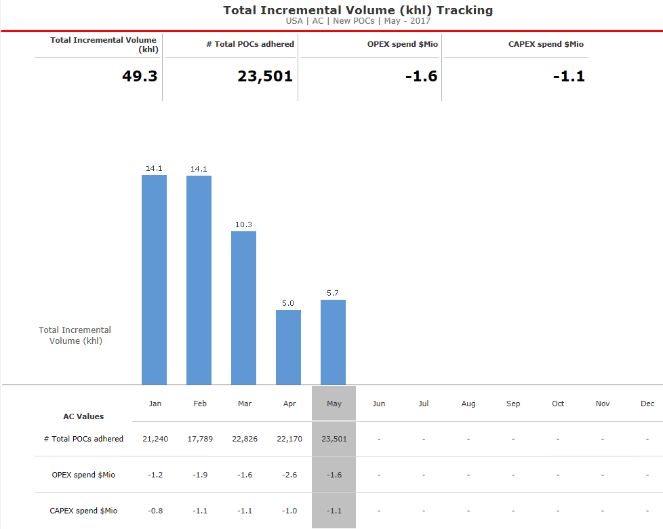
This new process has enabled deeper, rigorous analysis of each trade marketing investment
Dig Deeper Into:
What is the incremental volume when programs overlap? Is overlap good or bad?
Dig Deeper Into:
What types of POCs are we investing in? How are POCs without trade investment performing?
Dig Deeper Into:
What investment shifts could increase incremental volume and ROI?
ILLUSTRATIVE

Slide 10
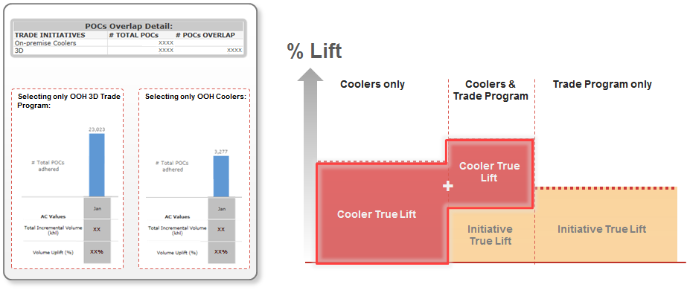
APT 2.0: By selecting an initiative in APT 2.0, we can know the isolated True Lift, even if there are overlaps with other POCs

Slide 11
Q&A

Slide 12
Check out the MasterCard swag at the MC Store!
Remember to fill out
the surveys on the breakouts you attended to get more points!

